Slide 1

Foreign Exchange Rate Prediction Model
Supervisor Name – Dr. Deep Suman Dev
Rohan Kr Basu
Roll No: 14400118018
Reg. No: 181440110020
Aneervan Ray
Roll No: 14400118036
Reg. No: 181440110002
Joshua Austin
Roll No: 14400118027
Reg. No: 181440110011

Slide 2
Objective!
The economics of supply and demand largely determine the exchange rate fluctuations. Calculating the supply and demand curves to determine the exchange rate has shown to be unfeasible.
The traditional linear forecasting methods suffer from their linear nature, since empirical evidence has demonstrated the existence of nonlinearities in exchange rates. In addition, the usefulness of the parametric and nonparametric, nonlinear models, has shown to be restricted.
For these reasons, the use of computational intelligence in predicting the foreign exchange rate is investigated, in which these previously mentioned limitations may be overcome. The method used here is ARIMA machine learning algorithm and LSTM.

Slide 3
Introduction!

Slide 4
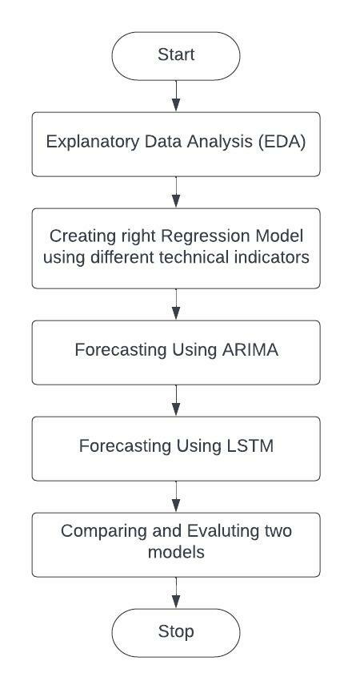
Proposed Methods!
This project has been done using the following steps:
Explanatory Data Analysis (EDA)
Data Visualization
Creating right Regression Model using technical indicators
Linear Regression
Multiple Linear Regression
Polynomial Regression
Forecasting using ARIMA
Forecasting Using LSTM
Comparing and Evaluating two models

Slide 5
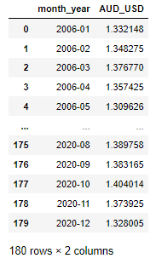
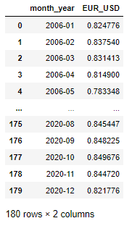
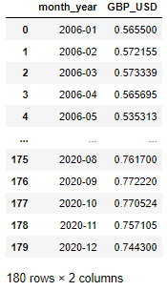
EXPLANATORY DATA ANALYSIS (EDA)
Exploratory data analysis (EDA) is used by data scientists to analyze and investigate data sets and summarize their main characteristics, often employing data visualization methods.
Exploratory Data Analysis or EDA is used to take insights from the data. Data Scientists and Analysts try to find different patterns, relations, and anomalies in the data using some statistical graphs and other visualization techniques. Following things are part of EDA.
Here in this project we have preprocessed the dataset by removing the rows which has NaN values manually.
After that we have extracted dataset for all the three regions by taking the average rate of each month, assuming mean represents the entire month.

Slide 6
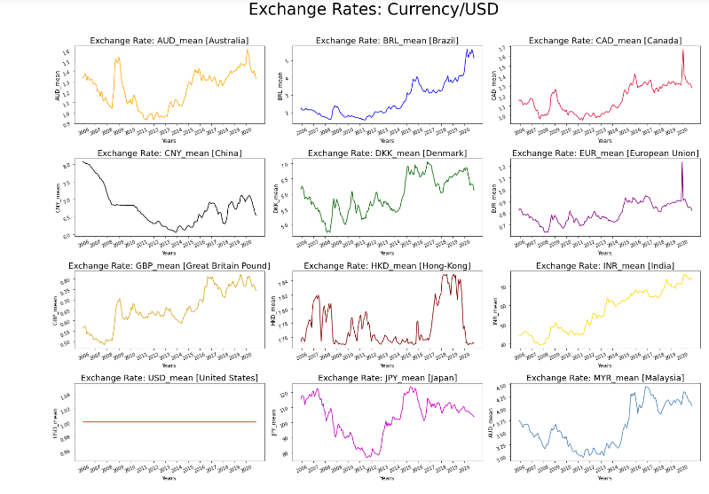
Data Visualization (EDA)
The FOREX dataset has exchange rate of 22 countries in total in a daily basis
Here in this project we have visualized 12 countries exchange rate among 22 countries

Slide 7
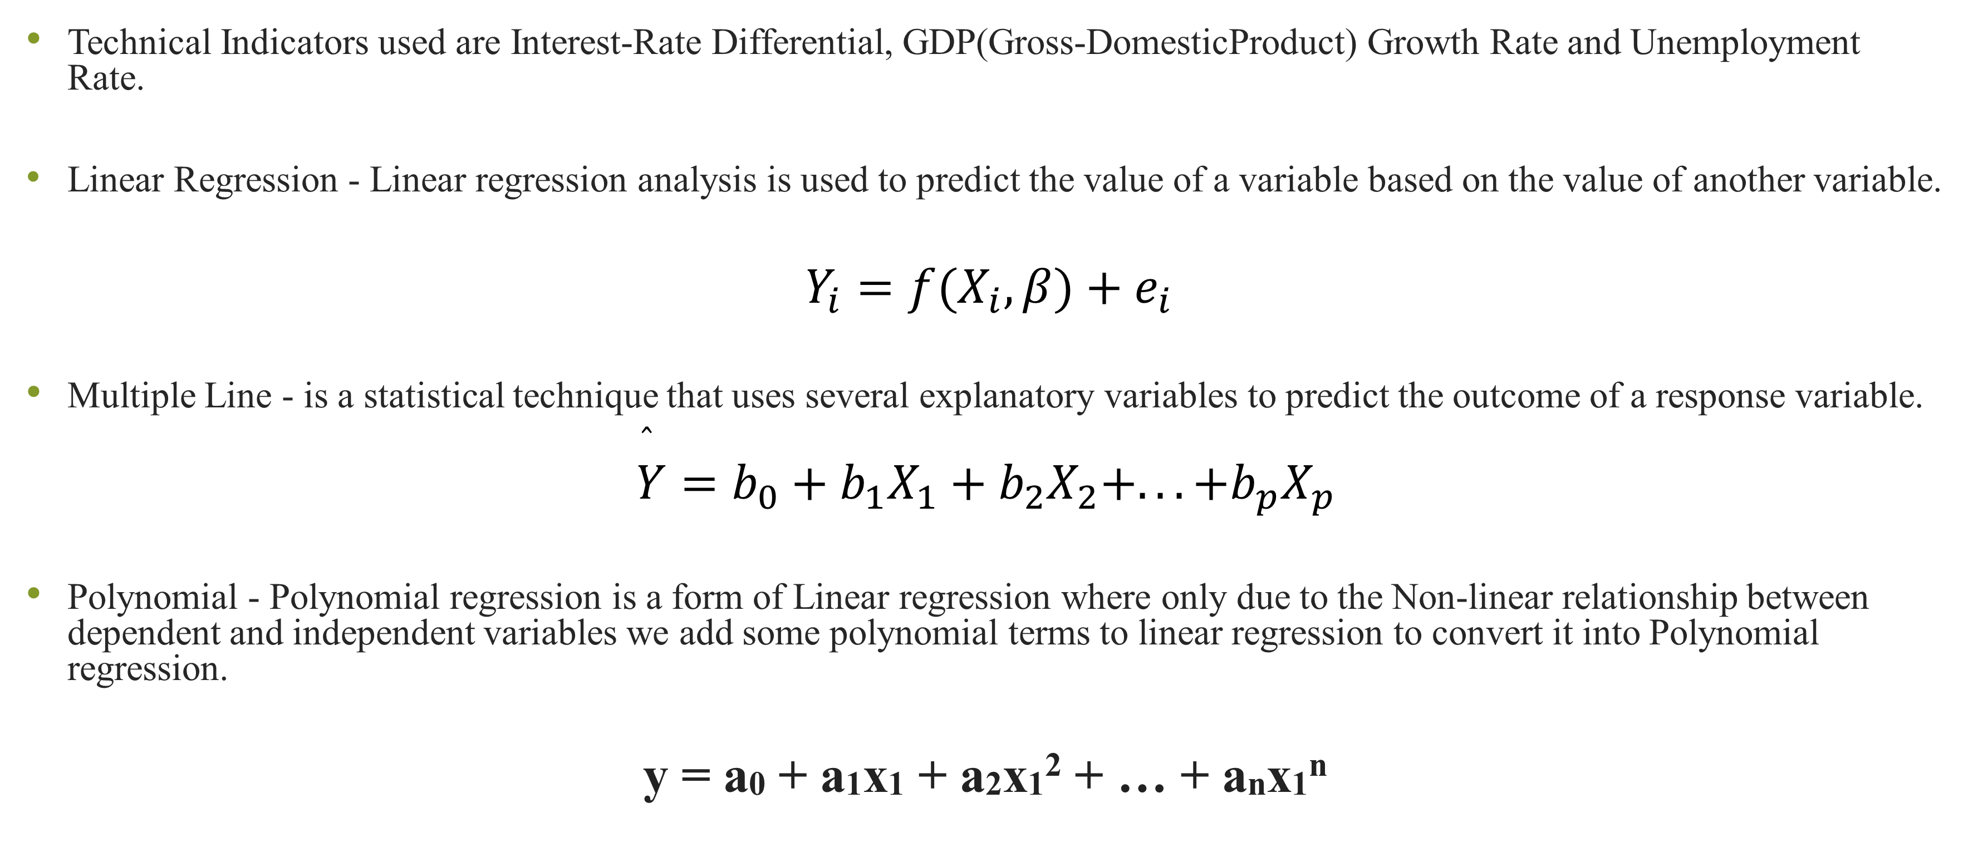
Regression Techniques
Technical Indicators used are Interest-Rate Differential, GDP(Gross-DomesticProduct) Growth Rate and Unemployment Rate.
Linear Regression - Linear regression analysis is used to predict the value of a variable based on the value of another variable.
$Y_{i}=f(X_{i},β)+e_{i}$
Multiple Line - is a statistical technique that uses several explanatory variables to predict the outcome of a response variable.
$$\overset{̂}{Y}=b_{0}+b_{1}X_{1}+b_{2}X_{2}+...+b_{p}X_{p}$$
Polynomial - Polynomial regression is a form of Linear regression where only due to the Non-linear relationship between dependent and independent variables we add some polynomial terms to linear regression to convert it into Polynomial regression.
y = a0 + a1x1 + a2x1² + … + anx1^{n}

Slide 8
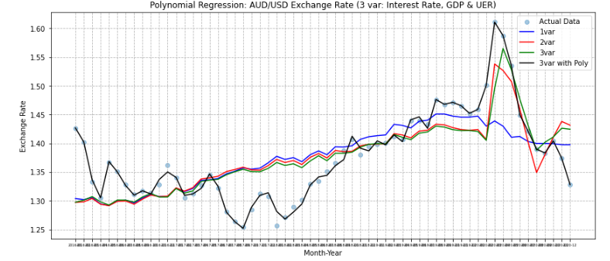
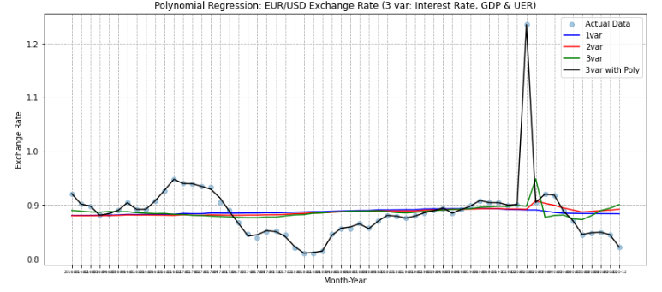
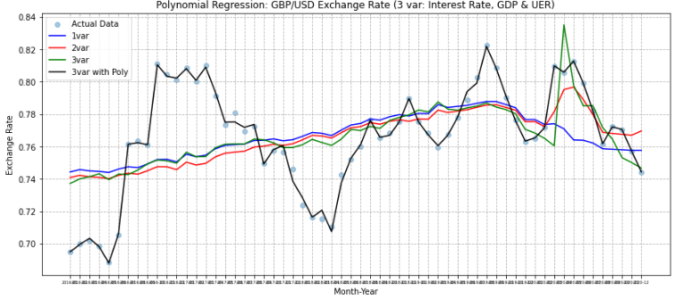
Since Polynomial Regression is giving maximum accuracy, we go ahead with this for the rest of the project in comparison to the other two.
Regression Techniques | Dependant Variables | Independant Variable | Overall Accuracy
 |  |  | Australia | European Union | United Kingdom
Linear Regression | Exchange Rate | Interest Rate | 42.89% | 00.49% | 15.60%
Multi-Linear Regression | Exchange Rate | Interest Rate, GDP and Unemployment Rate | 57.03% | 33.45% | 26.96%
Polinomial Regression | Exchange Rate | Interest Rate, GDP and Unemployment Rate | 99.47% | 99.90% | 99.62%

Slide 9
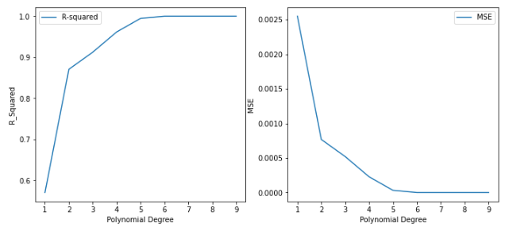
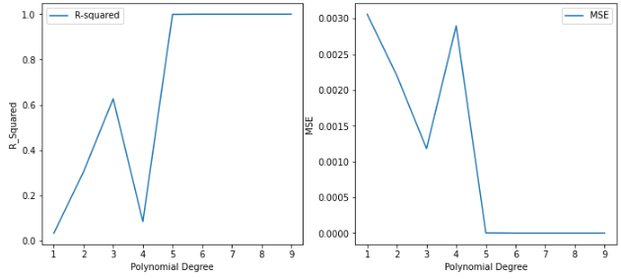
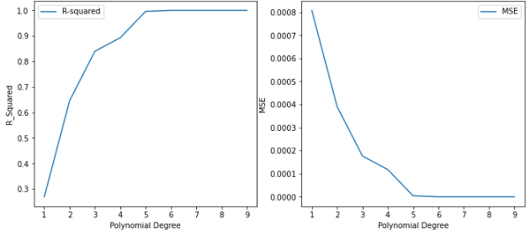
Which degree is the best, to neither overfit nor underfit the data?”
We know that we aim to find R-squared as high as possible, as it well explains the fact that the dependent variable (exchange rate) is affected by the independent variable(s). Apart from it, there is another metric that is able to evaluate the accuracy of our model: Mean Squared Error (MSE).
The higher the better for R-Squared, the lower the better of MSE.
As can be seen in both charts of three regions, the R-Squared and MSE improve significantly as the line increases from 1 to 5. (the higher the better for R-Squared, the lower the better for MSE). However, it reaches a peak at degree 5, after which there is no further improvement until degree 6. This indicates that a degree of 5 gives our model the best accuracy score.

Slide 10
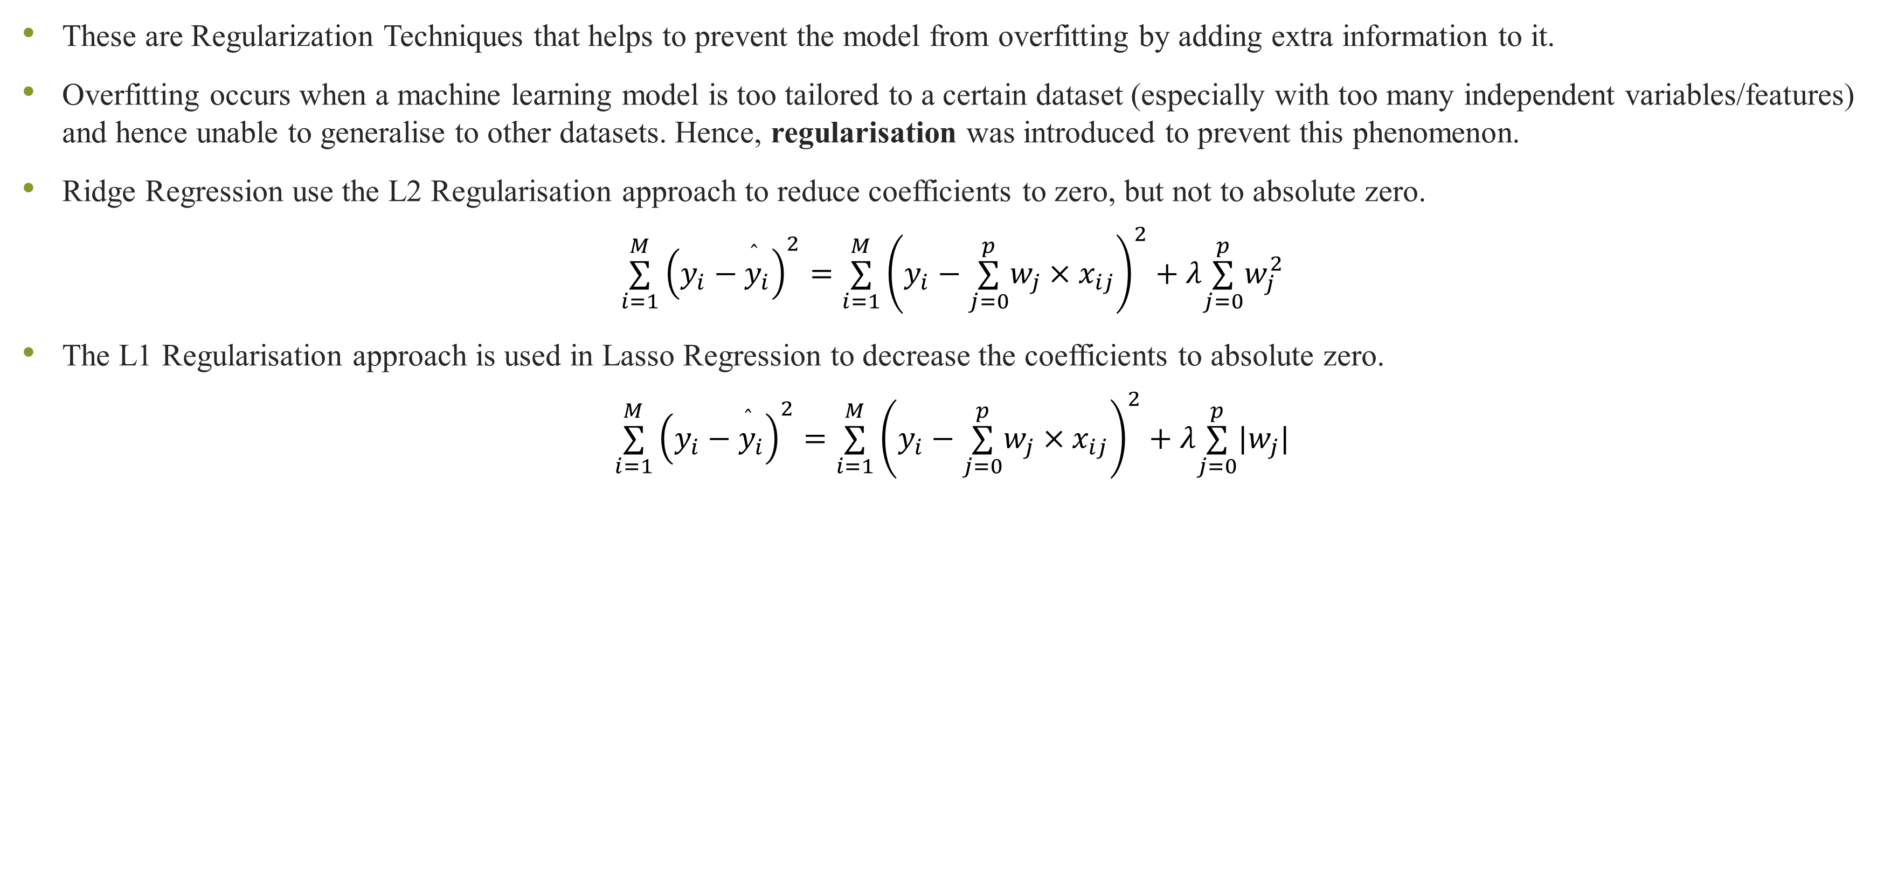
Ridge and Lasso Regression
These are Regularization Techniques that helps to prevent the model from overfitting by adding extra information to it.
Overfitting occurs when a machine learning model is too tailored to a certain dataset (especially with too many independent variables/features) and hence unable to generalise to other datasets. Hence, regularisation was introduced to prevent this phenomenon.
Ridge Regression use the L2 Regularisation approach to reduce coefficients to zero, but not to absolute zero.
$$\overset{M}{\underset{i=1}{∑}}{\left(y_{i}−\overset{̂}{y_{i}}\right)}^{2}=\overset{M}{\underset{i=1}{∑}}{\left(y_{i}−\overset{p}{\underset{j=0}{∑}}w_{j}×x_{ij}\right)}^{2}+λ\overset{p}{\underset{j=0}{∑}}w_{j}^{2}$$
The L1 Regularisation approach is used in Lasso Regression to decrease the coefficients to absolute zero.
$$\overset{M}{\underset{i=1}{∑}}{\left(y_{i}−\overset{̂}{y_{i}}\right)}^{2}=\overset{M}{\underset{i=1}{∑}}{\left(y_{i}−\overset{p}{\underset{j=0}{∑}}w_{j}×x_{ij}\right)}^{2}+λ\overset{p}{\underset{j=0}{∑}}|w_{j}|$$
 | Australia | European Union | United Kingdom
Multiple Linear Regression | 57.025% | 33.449% | 26.957%
Ridge Regression | 57.025% | 33.449% | 26.957%
Lasso Regression | 56.974% | 32.225% | 26.173%
Polynomial Regression | 99.468% | 99.899% | 99.616%

Slide 11
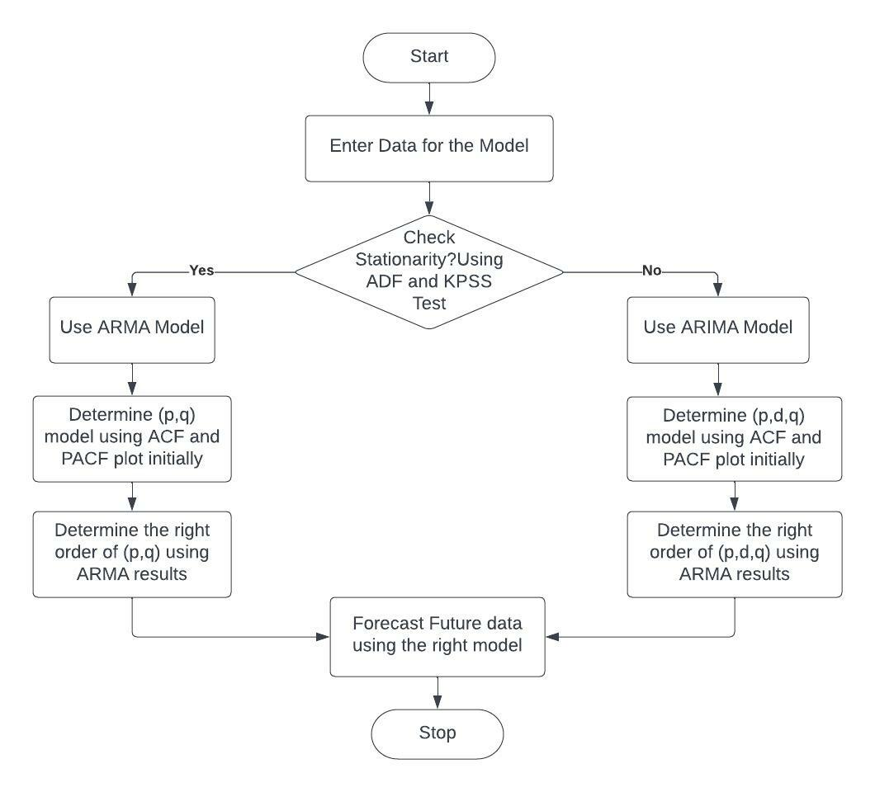
Time-Series Forecasting Using ARIMA and ARMA

Slide 12
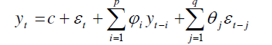
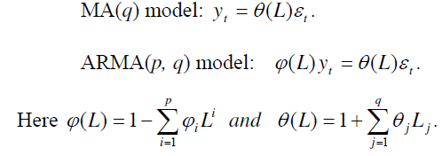
ARMA Model
An ARMA(p, q) model is a hybrid of AR(p) and MA(q) models that is suitable to model univariate time series. It is generally used when the dataset is already stationary. The future value of a variable is supposed to be a linear combination of p past observations, a random error, and a constant component in an Auto Regressive model i.e. AR(p) model. The AR(p) model may be stated mathematically as
Just as an AR(p) model regress against past values of the series, a Moving Average model i.e. MA(q) model uses past errors as the explanatory variables. The MA(q) model is given by
Autoregressive (AR) and moving average (MA) models may be efficiently coupled to generate the Autoregressive Moving Average Model i.e. ARMA models, which are a wide and valuable class of time series models. Mathematically an ARMA(p, q) model is represented as
The lag operator is commonly used to adjust ARMA models. Polynomials of lag operator or lag polynomials are used to represent ARMA models as follows

Slide 13
Stationary Testing
In order to produce accurate forecasts, the dataset must be "stationary." In a nutshell, stationary series do not change over time. Parameters such as mean, variance, and covariance, in particular, remain constant across time.
Test | Currency | Stat Value | p-Value | Critical Values |  |  | Conclusion
ADF Test |  |  |  | 1% | 5% | 10%
 | AUD/USD | -1.983 | 0.294 | -3.571 | -2.923 | -2.599 | Not Stationary
 | EUR/USD | -3.071 | 0.029 | -3.548 | -2.913 | -2.594 | Stationary
 | GBP/USD | -2.751 | 0.066 | -3.548 | -2.913 | -2.594 | Not Stationary
KPSS Test
 | AUD/USD | 0.722 | 0.012 | 0.739 | 0.463 | 0.347 | Not Stationary
 | EUR/USD | 0.118 | 0.100 | -3.548 | -2.913 | -2.594 | Stationary
 | GBP/USD | 0.246 | 0.100 | 0.739 | 0.463 | 0.347 | Stationary

Slide 14
Stationary Testing after First Differencing
Test | Currency | Stat Value | p-Value | Conclusion
ADF Test
 | AUD/USD | -6.128 | 0.000 | Stationary
 | GBP/USD | -6.440 | 0.000 | Stationary
KPSS Test
 | AUD/USD | 0.135 | 0.100 | Stationary
 | GBP/USD | 0.186 | 0.100 | Stationary

Slide 15
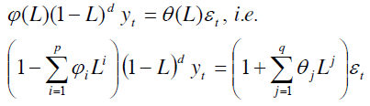
ARIMA Model
ARIMA stands for “AutoRegressive Integrated Moving Average,” an algorithm based on the premise that a time series' previous values may be utilised alone to forecast future values
. Time series with trend and seasonal characteristics are non-stationary by definition. As a result, from an application standpoint, ARMA models are insufficient to accurately characterise non-stationary time series, which are common in practise.
As a result, the ARIMA model, which is an extension of an ARMA model to incorporate non-stationarity, is developed. An ARIMA model is a combination of AR(p), I(d) and MA(q) models. A non-stationary time series is rendered stationary in ARIMA models by limited differencing data points. The ARIMA(p,d,q) model is mathematically expressed using lag polynomials, as shown below.
The orders of the autoregressive, integrated, and moving average portions of the model are denoted by p, d, and q, which are all integers higher than or equal to zero.
The difference level is controlled by the integer d. In most circumstances, d=1 is sufficient. It reduces to an ARMA(p,q) model at d=0 i.e. the dataset is already in a stationary form. In this paper we have computed the d as shown above in the section Stationary Analysis and it came out d=1.
ARIMA(p,0,0) represents the AR(p) model, whereas ARIMA(0,0,q) represents the MA(q) model.
ARIMA(0,1,0), y_{t} = y_{t-1} + ε_{t} is a unique model that is referred to as the Random Walk model [35, 36, 39]. Non-stationary data, such as economic and stock price series, are commonly employed.

Slide 16
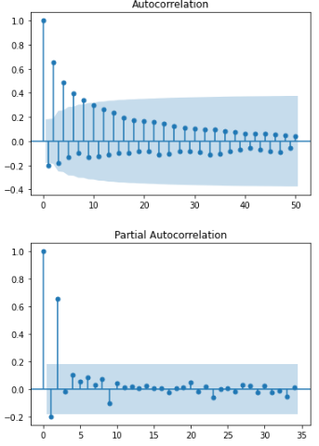
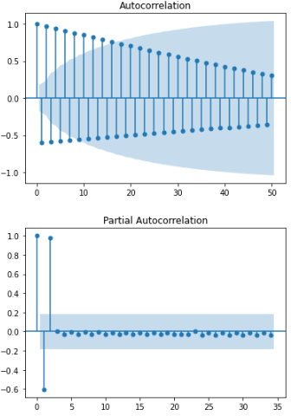
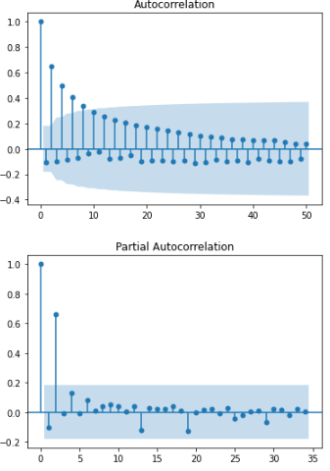
Autocorrelation Function (ACF) and Partial Autocorrelation Function (PACF):
 | Australia | European Union | United Kingdom
AR(p) | 2 | 2 | 1
MA(q) | 3 | 3 | 4

Slide 17
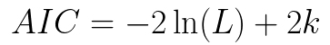
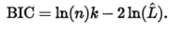
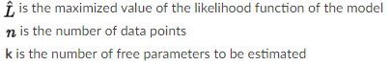
EVALUATION:
To find the optimal ARIMA model we need to look at two Information Criterion values those are Akaike Information Criterion (AIC) and Bayesian Information Criterion (BIC). The lower the value of AIC and BIC, the better model is
ARIMA MODEL RESULT
Currency | (p, d, q) | AIC | BIC
Australia | (2, 1, 3) | -284.264 | -269.722
 | (1, 1, 1) | -280.308 | -271.998
 | (0, 1, 1) | -282.531 | -276.298
European Union | (2, 0, 3) | -184.776 | -170.115
 | (2, 0, 2) | -179.037 | -166.471
 | (1, 0, 1) | -180.712 | -172.435
Great Britian Pound | (1, 1, 4) | -279.859 | -265.316
 | (1, 1, 1) | -281.644 | -273.334
 | (0, 1, 0) | -283.93 | -279.775

Slide 18
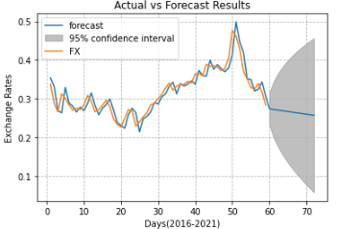
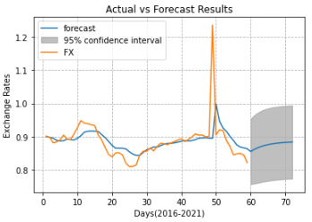
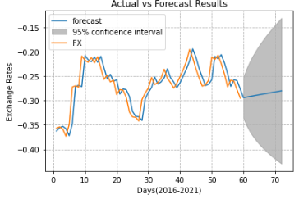
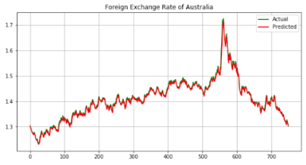
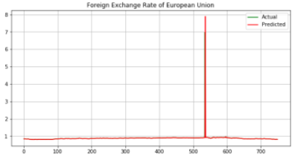
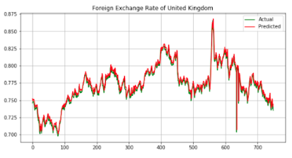

Slide 19
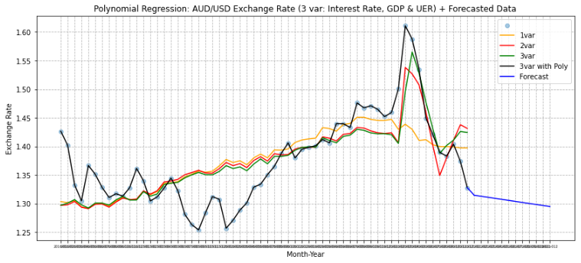
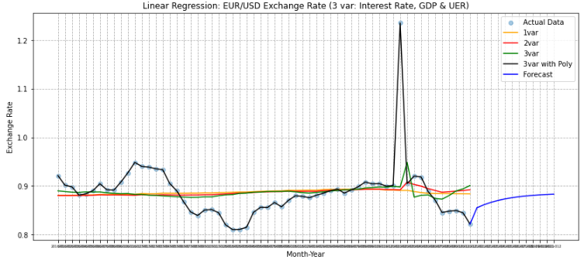
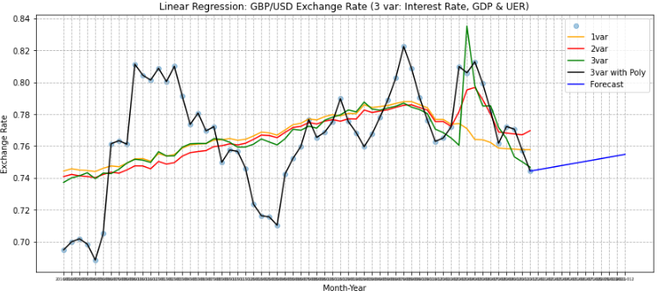
ARIMA Forecasted Graph along with Polynomial

Slide 20
LSTM
LSTM stands for Long-Short Term Memory which is a special kind of artificial Neural Network used in deep learning which is capable of handling Long Term Dependencies.
LSTM has feedback connections i.e. it is capable processing the entire sequence of data, apart from single data points.
In this project, we will implement the LSTM Recurrent Neural Network to predict the Foreign Exchange Rate.
The LSTM model will be trained to learn the series of previous observations and predict the next observation in the sequence.
We will apply this model in predicting the foreign exchange rate of Australia, European Union and United kingdom.

Slide 21
Understanding How LSTM works

Slide 22


Slide 23
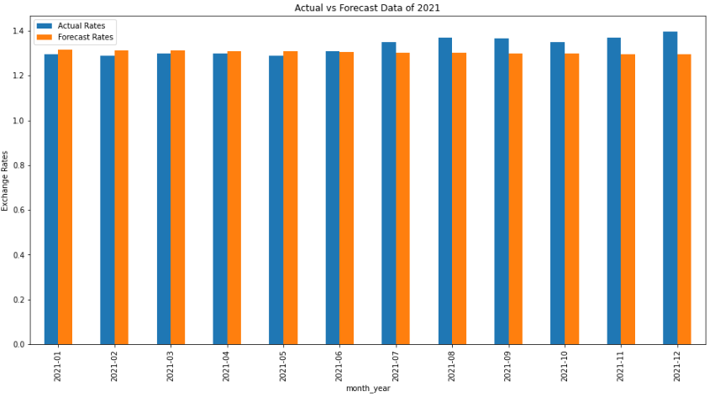
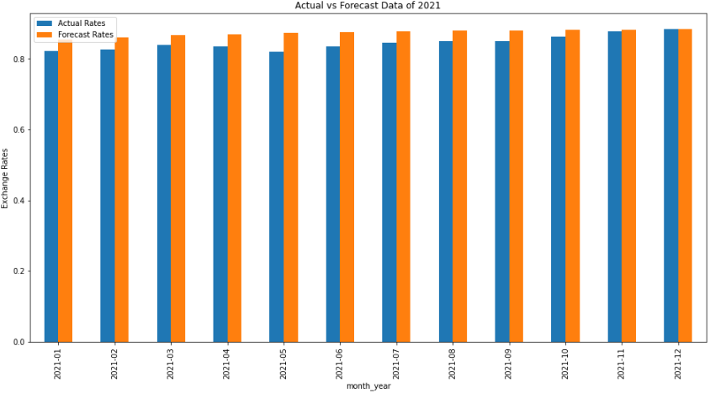
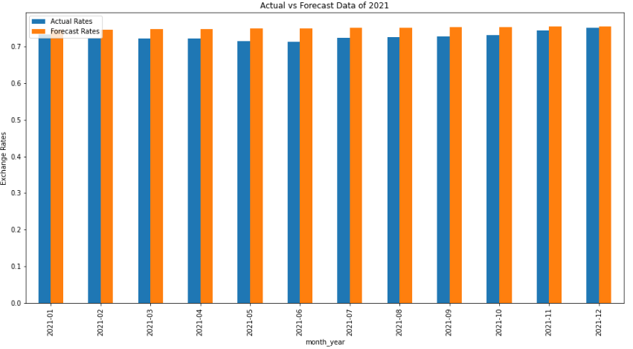
Performance Measures! - ARIMA
Countries | Performance Measures |  |  |  |  |  |  | Overall Accuracy
 | MAPE | ME | MAE | MPE | RMSE | Correlation | MinMax
Australia | 0.030161 | -0.026745 | 0.040922 | -0.019199 | 0.050711 | -0.913145 | 0.030085 | 96.9839%
European Union | 0.034197 | 0.028390 | 0.028622 | 0.033935 | 0.031670 | 0.769864 | 0.032818 | 96.5802%
United Kingdom | 0.031194 | 0.022557 | 0.022557 | 0.031194 | 0.024358 | 0.593215 | 0.030096 | 96.8806%

Slide 24
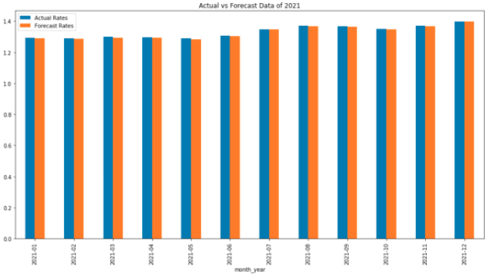
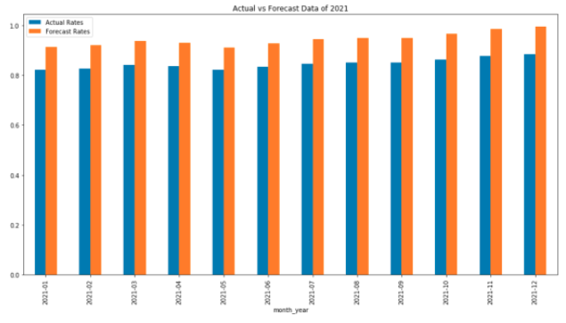
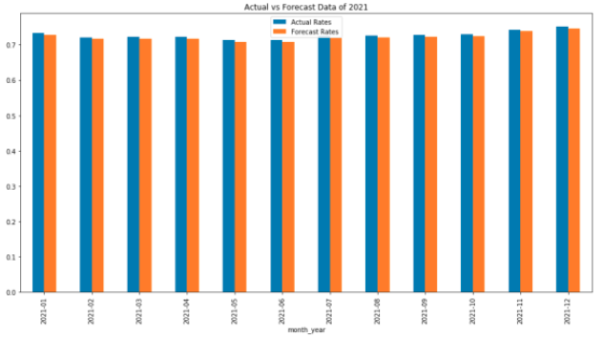
Performance Measures! - LSTM
Countries | Performance Measures |  |  |  |  |  | Overall Accuracy
 | MAPE | ME | MAE | MPE | RMSE | MinMax
Australia | 0.004477 | 0.005972 | 0.005972 | 0.004477 | 0.005998 | 0.004457 | 99.552312 %
European Union | 0.132234 | 0.111902 | 0.111902 | 0.132234 | 0.112055 | 0.116780 | 86.7766%
United Kingdom | 0.02315 | 0.001686 | 0.001686 | 0.002315 | 0.001691 | 0.002310 | 99.7684%

Slide 25
LSTM vs ARIMA Model
Countries | Overall Accuracy ARIMA | Overall Accuracy LSTM
Australia | 96.98% | 99.55%
European Union | 96.58% | 86.77%
United Kingdom | 96.88% | 99.77%

Slide 26
Conclusion
In this paper we have forecasted exchange rate for Australia against USD dollar which does not contain any seasonality. For Australia, the dataset was in a non-stationary form which we have made stationary with first differencing and on it we implemented ARIMA model. To forecast the exchange rate with more accuracy, we have used technical indicators as well, such as Interest Rate Differential, GDP Growth Rate and Unemployment Rate which are the important factors for the exchange rate. So in this paper the forecasted exchange rate has given good accuracy even in this Covid-19 situation due to the fact that we have taken into consideration this factors too. The two essential functions in ARIMA i.e. AIC and BIC, and the ACF and PACF plots that are widely employed for ARIMA model selection have been shown. For evaluating the accuracy of forecasting models, we looked at a few key performance indicators. More than one metric has been employed in practice to gain a realistic understanding of the total forecasting error. The seven performance measurements and forecast diagrams we produced for Australia demonstrate our sufficient comprehension of the selected forecasting model and its successful implementation with attaining an accuracy of 96.98%. Time series forecasting is a rapidly expanding field of study, with much of room for future research. One of them is the Combining Approach, which entails combining a variety of various and disparate methodologies in order to increase prediction accuracy. A great deal of research has been done in this area, and many combining approaches have been presented in the literature.

Slide 27
THANK YOU!!!

